Slide 1



Introduction to Majisemi: ' Serious' B2B marketing supp ort starting with webinars
For those considering Majisemi for the first time
Seminars with strong customer attraction
No.1
Seminars strong in acquiring new business negotiations
No.1
Seminars chosen by IT managers
No.1
Survey by Japan Marketing Research Organization Overview: 2021 Service Comparison Impression Survey

Slide 2
Introduction
Purpose of today's meeting
For companies considering "Majisemi" for the first time, we will discuss the following topics.
Hearing about challenges in marketing
How will you utilize Majisemi?
©2018 MAJISEMI Inc.

Slide 3
Hearing
©2018 MAJISEMI Inc.

Slide 4
Hearing
Issue Identification
■ About the products you want to introduce in the seminar
・Which product or service?
・Who is the target audience (who do you want to invite to the seminar)?
・Industry, company size, department, position, etc.
※ Majisemi's areas of expertise are "IT departments, DX departments, security departments across all industries, and production/manufacturing departments in factories"
・What are the competing products?
・What are the strengths and differentiation points compared to competing products?
©2018 MAJISEMI Inc.

Slide 5
Hearing
Issue Identification
■ On the necessity of seminars (webinars)
・What is considered important as a means of lead acquisition?
・Seminars (webinars)
・Websites (content marketing)
・Real exhibitions
・比較サイト
・GoogleやFacebookなどへの広告
・テレアポ
・その他
■ Budget situation
・リード獲得単価、アポ獲得単価
・セミナー（ウェビナー）の予算の有無、及び金額
・上記リード獲得手段の予算の割合
・予算の策定、決定時期
©2018 MAJISEMI Inc.

Slide 6
Hearing
Issue Identification
■ Purpose/challenges of seminars (webinars)
・より多くのリードを獲得したい／集客できない
・ターゲットに合ったリードを獲得したい／リードの質が悪い
・ウェビナーから商談につなげたい／商談につながらない
・ウェビナーの運営を代行してほしい／運営が大変
・まずはスモールスタートでウェビナーをやってみたい
・その他
・ウェビナーを活用した、東南アジアにおける新規顧客開拓やテストマーケティング
©2018 MAJISEMI Inc.

Slide 7
Why webinars?
©2018 MAJISEMI Inc.

Slide 8
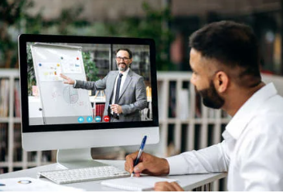

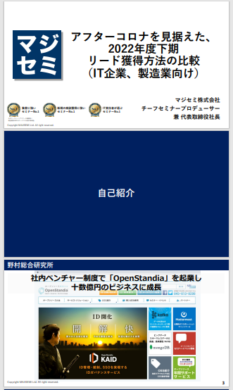
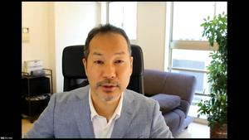
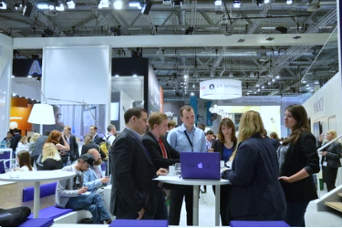
The role of webinars in B2B marketing
Webinar
as a Service
Lead acquisition
Lead Nurturing
Proposal and order
課題に
気づいてない
課題に気づき
社内で検討
Products/services
Searching for candidates
Focusing on products/services
Evaluation, selection, internal approval
課題に気づかせる
課題について深く理解させ、
解決方法を提示する
Reach out to customers faster than competitors and support problem-solving
Be included in the consideration set of several to a dozen companies, and remain as one of the final 2-3 candidates
Be chosen from the final 2-3 candidates
Utilization of Webinar Content
Make them aware of the issue.
Help them deeply understand the issue.
Reach out to customers before competitors and make them aware of our company.
When hosting a webinar,
a lot of content is generated.
● Presentation materials → White Paper
● Presentation video → YouTube, Social Media
● Presentation content → SEO articles, blogs
Webinar
Field Sales
Website
Content Marketing
Webinar
Social Media Advertising
Deepen understanding of challenges.
Also provide competitive comparison information and information about our products.
For nurturing existing leads.
In-person trade show
Online event
Downloadable Materials
Field Sales
©2018 MAJISEMI Inc.

Slide 9

Email Advertising
Positioning of Webinars in Lead Acquisition
planning
Cost per Lead
Telemarketing
30,000 yen
Webinar
In-person trade show
Listing/Social Media Advertising
Visitor
14,500 JPY
Majisemi
Club
10,000 yen and up
10,000 yen
Online
Exhibition
(Large-scale Webinar)
Comparison Sites
Downloadable Materials
On-Demand
Video distribution
5,000 yen
In-person trade show
Joint exhibition
Low
Interest
High
©2018 MAJISEMI Inc.

Slide 10
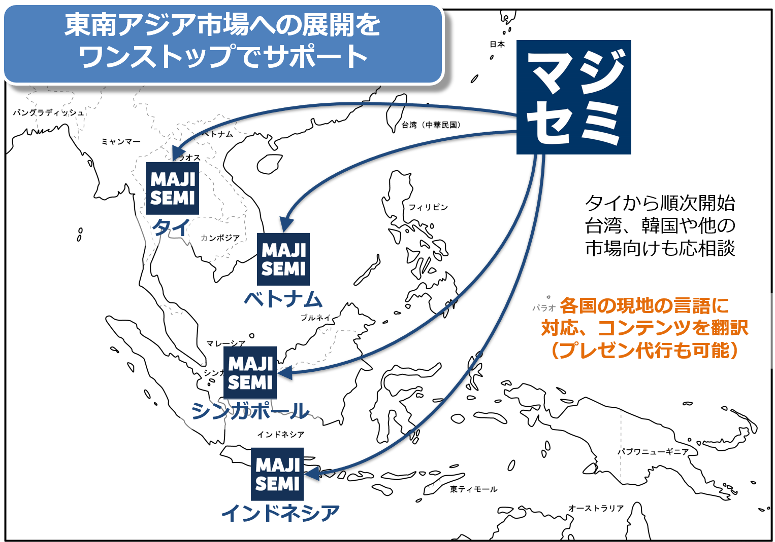
Support for expansion into Southeast Asia using webinars
planning
Webinars can be broadcast to Southeast Asia at almost the same cost as for Japan.
Your company only needs to prepare a presentation video (plus slides) in Japanese (or English).
Majisemi handles everything from adding local language subtitles, translating slides, to the day of the broadcast.
Options include post-webinar lead follow-up and secondary use of webinar videos with local language support.
Promoting joint exhibition at trade shows held in Southeast Asia.
©2018 MAJISEMI Inc.

Slide 11


Why start with webinars?
planning
Cold calls or direct mail from no prior contact can lead to distrust.
First, by holding webinars that 'provide valuable information', you can establish the initial contact and
gain 'trust and credibility'.
Features of webinars
When emailing the entire list
Can provide an 'interactive experience'
Live Q&A sessions
Demos and factory tours while receiving questions and requests
Can obtain 'live feedback'
Pre/post surveys, as well as polls and questions during the presentation
Can attract 'highly interested' viewers
In small webinars, participants are those who are troubled by issues your products/services can solve
Build trust by 'sharing the space'
Recognized as a 'teacher'
Building trust through communication such as Q&A
0.7%
70%
When materials are sent via email
is about 100 times!
When emailing seminar participants
Face-to-face communication with customers
can enhance trust and credibility
The response to follow-up afterwards
is approximately 100 times different
※ According to our research
©2018 MAJISEMI Inc.

Slide 12
Overview of Majisemi's services
©2018 MAJISEMI Inc.

Slide 13
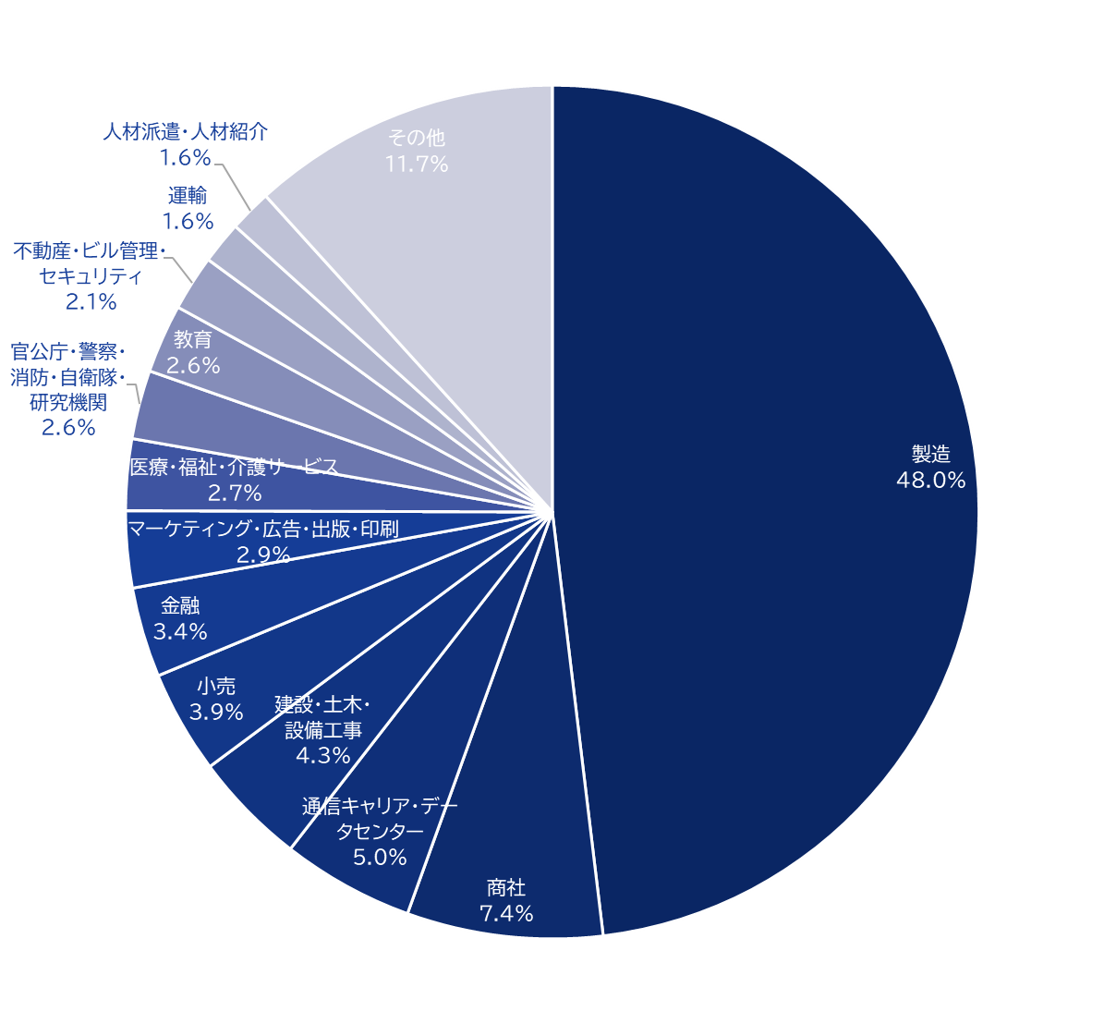
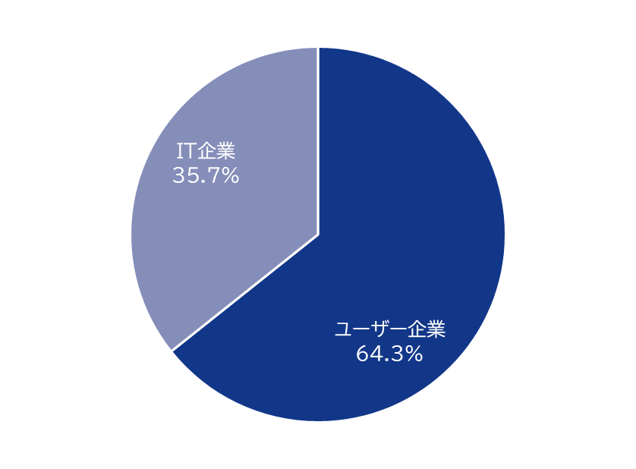
Majisemi's house list
Webinar
as a Service
Customer attraction power
Possesses approximately 250,000
house list entries!
Breakdown of user companies
House
List
Overall
*Estimated from seminar applicants from 2020 to 2024
©2018 MAJISEMI Inc.

Slide 14
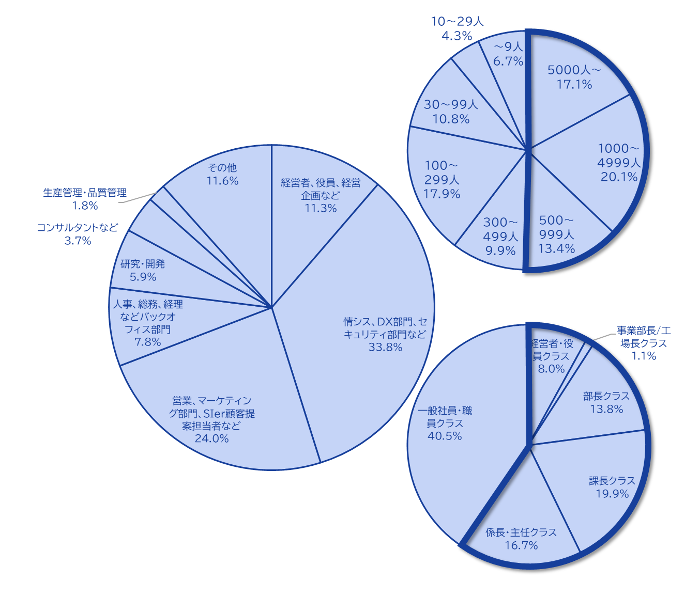
Majisemi's house list
Webinar
as a Service
The Majisemi list is
is almost exclusively focused on the following attributes.
Nearly half work at
Employed at large companies
Company
Size
All industries × Information systems departments, DX-related departments
All industries × Security departments
Manufacturing × Production and manufacturing departments
All industries × Back office departments
IT Companies × All Job Functions
Job function
Breakdown of house list
At Majisemi, to have more participants who match your products/services, we do not use attribute specification (segmentation) when attracting customers via email, etc.
Instead, we set the webinar theme (title, announcement text) to
on behalf of Majisemi,
adopting a method that increases the proportion of your target audience.
Emails are not sent to all contacts, but prioritized for those highly interested in the set theme.
Position
Primarily managers
©2018 MAJISEMI Inc.

Slide 15





Why is it necessary to hold webinars?
Webinar
as a Service
The value of cold leads and the importance of repeating webinars
Lead acquisition
Nurturing and business negotiations
Contract
1 individual
Hot leads
3 participants
Seminar hosting
30 participants
Cold lead
21 individuals
Repeatedly held
It's important to do so!
27 individuals
By repeatedly holding webinars, including past participants,
to efficiently acquire new leads and nurture them.
If left unattended
21 individuals
80% sign contracts with
competitors within 2 years
Majisemi conducts long-term follow-ups with past participants,
and also offers 'Maji Follow Plus' to assist in appointment acquisition.
(SiriusDecisions survey)
©2018 MAJISEMI Inc.

Slide 16








Reasons to use Majisemi
Webinar
as a Service
Delegate your webinar operations to us
Repeat PDCA to explore winning patterns
Planning
Attracting attendees
Seminar
Secretariat
Moderation
Appointment acquisition
(Optional)
Survey aggregation
Report creation
SEO article creation
Video production
(Optional)
Review &
Improvement
With a one-stop service,
from start to finish
Majisemi handles it all, so
All support included
with only the cost of attracting attendees!
Focus on the presentation
on the day!
©2018 MAJISEMI Inc.

Slide 17

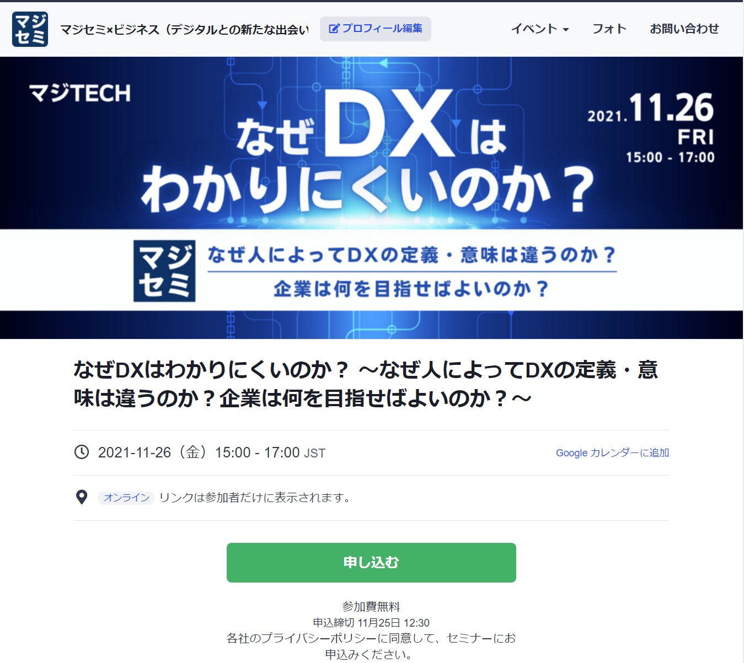
Reasons to use Majisemi
Webinar
as a Service
In a single webinar, it is possible to acquire new leads and nurture existing leads simultaneously
Audience acquisition page creation & publication
Attracting attendees
Majisemi management screen
Reminder distribution 1 week before & the day before
Majisemi audience acquisition slot
Attracting customers with Majisemi
Majisemi slot
Applicant data
Distribution of participation URL
Plan finalized
Applications to your customer acquisition slot
Applications are
not subject to charges, regardless of the number!
For nurturing your existing
house list nurturing,
reviving dormant customers,
and acquiring new leads through your website, etc.,
please make full use of this!
Your audience acquisition slot
After publication
We will provide
will be provided
Attract customers through your company's house list and website, etc.
Your audience acquisition slot
Applicant data
We will create a dedicated customer acquisition site URL for you
we will create a dedicated customer acquisition site URL for your company.
Delivery of all leads to your company
©2018 MAJISEMI Inc.
*Excludes disqualified applicants and those on the waiting list

Slide 18
Successful webinar case studies

Slide 19
(Case 1) "Changed the theme and achieved over 120 attendees" <Company C>
■ Customer's challenges
・Primarily sold by SIers, focusing on server/infrastructure services
・We are hosting webinars in-house but cannot attract attendees
・Even when we request media to attract attendees, we fail to do so
■ Plan utilized
・Visitor (later transitioned to Majisemi Club)
■ Response by Majisemi
・Using know-how from hosting 1,000 webinars ann ually and tools like 'trend analysis tool', Maj isemi plans and proposes 'attractive projects'
■ Results
・Achieved attendance of over 120 people
©2018 MAJISEMI Inc.

Slide 20
(Case 2) "While exploring themes, achieved over 50% appointment acquisition" <Company T>
■ Customer's challenges
・Tool vendors
・Focused on marketing through exhibitions, but struggled to convert to business discussions
■ Plan utilized
・Visitor (later transitioned to Majisemi Club)
■ Response by Majisemi
・Repeatedly hosted webinars while exploring themes that 'attract a certain number of attendees and lead to business discussions'
■ Results
・Improved conversion rate from 10%→20%→50% while attracting about 30 attendees each time
・Presenters themselves conduct follow-up after webinars
©2018 MAJISEMI Inc.

Slide 21
(Case Study 3) "Switched to online and acquired 20% appointments" <Company Z>
■ Customer's challenges
・Global IT company developing and selling packaged products and SaaS
・Hosting offline seminars but struggling with attendance and participation rates
・Not leading to business discussions
■ Plan utilized
・Visitor
■ Response by Majisemi
・Proposal for online (webinar)
・Implemented 'seminar planning that leads to business discussions'
■ Results
・30 registrations→achieved 6 appointments
©2018 MAJISEMI Inc.
‹#›

Slide 22
(Case Study 4) 'Acquired over 15% appointments with follow-up outsourcing' <Company I>
■ Customer's challenges
・Infrastructure IT venture company also developing its own products
・Hosted several webinars with good attendance but not leading to business discussions
・Busy staff unable to provide sufficient sales follow-up after webinars
■ Plan utilized
・Visitor
■ Response by Majisemi
・Implemented 'seminar planning that leads to business discussions'
・Implemented 'Majifolo', a follow-up service that makes calls immediately after webinars
■ Results
・50 registrations→achieved 8 appointments
©2018 MAJISEMI Inc.

Slide 23
(Case Study 5) "AI presented and acquired 20% appointments" <Company A>
■ Customer's challenges
・Foreign SaaS vendor
・Achieving attendance targets every time but not leading to business discussions
・Issues with presentation materials and content
■ Plan utilized
・Majisemi Club
■ Response by Majisemi
・Implemented AI-generated speech scripts and AI digital human presentation services
・Implemented 'Majifolo', a follow-up service that makes calls immediately after webinars
■ Results
・20 registrations→achieved 4 appointments
©2018 MAJISEMI Inc.

Slide 24
About plans and pricing
©2018 MAJISEMI Inc.

Slide 25
Plan Comparison
Pricing Plans
Recommended
 | Visitor | Majisemi Club Light | Majisemi Club Business Negotiation Guarantee
Recommended for these individuals! | Planning to hold webinars 1 to 2 times a year | Planning to hold webinars 4 times or more annually Want to reduce cost per lead | Want business negotiations (appointments) rather than just attracting attendees Want a guarantee
Cost per lead comparison | 14,500 JPY | 12,000 JPY (10 people monthly) 10,000 JPY (for additional attendees) | 20,000 JPY (30 people over 3 months) 13,500 JPY (for additional attendees)
Not subject to duplicate charges for past applicants ※Refer to each plan's description for details | None | Available | Available
Business discussion (appointment) guarantee ※Refer to each plan's description for details | None | None | Available
Contract period | Per session | Monthly (Automatic renewal) | Every 3 months (Automatic renewal)
©2018 MAJISEMI Inc.

Slide 26
Are there any services other than the basic plan that interest you?
Service Map
Limited slots
First-come, first-served
Exhibition
Joint exhibition
Your company's existing leads
(Not subject to charges)
Webinar hosting
Lead follow-up, proposal, and order
Recommended
New service
Presentation script/materials
Creation outsourcing
AI-powered presentation outsourcing
Webinar hosting
(Visitor or Majisemi Club)
Follow-up immediatel y after the webinar
(Maji Follow)
Sales outsourcing
(Proposal and order)
(Maji Sales)
Your company Inside sales
or Fiel d sales
Recommended
New service
Many companies
Will be utilized
On-demand
Distribution
Rebroadcast
2-step
Webinar
Many companies
Will be utilized
Utilization of webinar content
Many companies
Will be utilized
Many companies
Will be utilized
Recommended
New service
SEO article
Creation
Full video
Provided/Free
Full video
Provided/Secondary use
Summary
Video production
SEO video creation
©2018 MAJISEMI Inc.

Slide 27
Majisemi Club or visitor?

Slide 28

Plan Comparison
Pricing Plans
Visitor
Seminar hosting 30 participants attracted
Majisemi Club
Seminar hosting 30 participants attracted
(Monthly fee)
10 additional participants each month
10 participants × @12,000 JPY
Attraction slots
10 people
Utilize the free bonus for 20 participants
Attraction slots
20 people
Billing
30 participants × 14,500 JPY = 435,000 JPY (excluding tax)
Billing
10 participants × 12,000 JPY = 120,000 JPY (excluding tax)

Slide 29
Majisemi Club Initial 20 People Free Benefit
Campaign
By contracting Majisemi Club, you can use this benefit at the time of your first event.
You can cancel at any time. Even if you cancel after one session, it is more advantageous than being a visitor.
Image of hosting using special offers
 | January | February | March | April
Membership Fee Billing Amount | 120,000 yen | 120,000 yen | 120,000 yen | 120,000 yen
Additional attendance slots | +10 people | +10 people | +10 people | +10 people
Campaign-Based Additional attendance slots (free) | +20 people | - | - | -
Remaining Attendance Slots | 30 participants | 10 people | 20 people | 30 participants
Seminar hosting | 30 participants | - | - | 30 participants
You can purchase additional audience slots at any time
(at a cost-effective 10,000 yen each) to
allowing additional webinars to be hosted
First 20 participants free
Immediately host a webinar for up to 30 participants
Webinar hosting available
If hosting only once for the first time and canceling at the end of March (notification by the end of February),
Only the membership fee of 120,000 yen x 3 months will be charged.
©2018 MAJISEMI Inc.

Slide 30
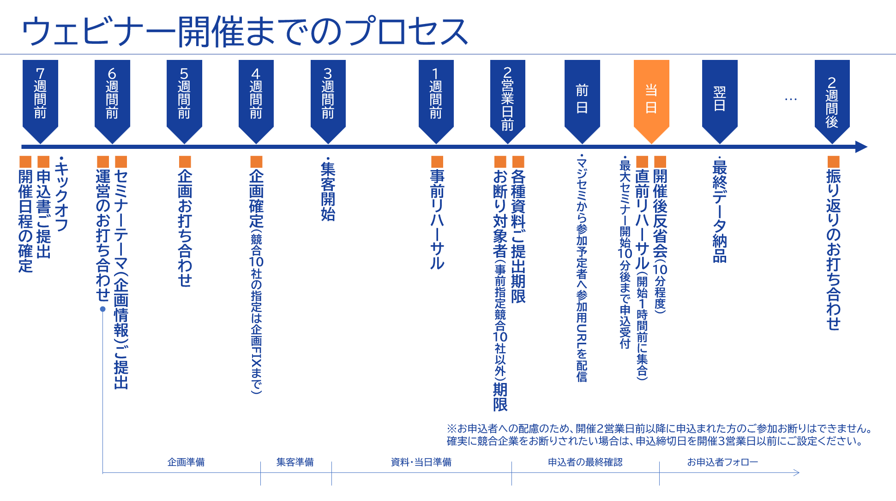
©2018 MAJISEMI Inc.

Slide 31
Take this opportunity to start with Majisemi!
Clients using Majisemi have shared feedback such as
The audience turnout is good,
and it leads to business negotiations.
Awareness has increased, and inquiries from the web
have also increased.
The staff (attendants and cast) were excellent,
making it easier to host seminars.
We have received comments like these.
And most client companies repeatedly host seminars with Majisemi.
However, you might have the following concerns.
"Will the target companies really attend?"
"How much easier will the operation become?"
For such customers,
we offer the 'Majisemi Club Membership First 20 Participants Free' campaign.
Please try Majisemi!
©2018 MAJISEMI Inc.

Slide 32
~Please check later~
(For your reference) Other information

Slide 33


Reasons to use Majisemi
Webinar
as a Service
Delegate your webinar operations to us
A dedicated planning manager will create the title and announcement text!
Planning
A Majisemi planning specialist with IT knowledge will collaborate with you to create a webinar plan that achieves audience acquisition and business negotiations.
STEP1
STEP2
STEP3
Final application
Please enter product name, product information, target, and pain points into the management system.
Planning meeting
We will hold a one-hour meeting online.
We will align details based on the preliminary information.
Plan finalized
Press the approval button in the management system to finalize the plan.
Our company
Preparation for
Publishing the attraction page
Starts!!
By email
Confirmation
Attendants (seminar secretariat) will support you until the webinar is hosted!
Attendant
(Seminar secretariat)
An attendant with experience in managing 1,000 seminars annually will accompany you until the seminar is held.
Feel free to consult us with any concerns!
STEP4
STEP 5
STEP6
On the day
・Moderation
・Collecting surveys
Publication of the recruitment page
Creation of the application page
Handling of applicants
・Responding to inq uiries ・Reminders
・Issuing the participation URL
Rehearsal
・Confirming the day's flow and requests ・Checking the speaker's connection env ironment ・Confirming preparation status
Report creation
Cast
Cast
©2018 MAJISEMI Inc.

Slide 34
Reasons to use Majisemi
Webinar
as a Service
Dedicated support from the planning stage
Planning stage flow
Preliminary preparation
The person in charge will gather information on the seminar theme shared in advance and create a proposal for promotional angles.
Planning meeting
We will hold a meeting for about one hour. We will propose promotional angles while aligning details.
Creation of the proposal
Based on the content aligned in the meeting, the person in charge will draft the title and announcement text.
Submission of the proposal
After creating the proposal, the person in charge will submit it via email.
Confirmation of the proposal content
Please review the proposal content and share any feedback you may have.
Finalization of the proposal
Once the content review and feedback revisions are complete, press the approval button in the management system to finalize the plan.
Preparation for
Start of publication preparation
©2018 MAJISEMI Inc.

Slide 35
Flow of the event
On the day of the event
Webinar
as a Service
Event time
Distribution tools
General flow of the seminar
You can choose from 5 slots
(Weekdays only *No events on weekends or holidays)
The basic duration for one seminar is 1 hour
You can choose from 2 types
*We recommend Zoom for its functionality and delivery quality
*For seminars hosted by Majisemi, an additional fee is charged for events longer than 1 hour (150,000 yen/hour)
10:00-11:00
Registration starts
15 minutes
11:00-12:00
Opening
(Majisemi Cast)
Zoom
Teams
13:00-14:00
5 minutes
Presentation
14:00-15:00
30-40 minutes
Poll
3:00 PM - 4:00 PM
Q&A
(Navigated by Majisemi Cast)
* On Mondays, only the 2:00 PM and 3:00 PM sessions are available
* Majifolo is only conducted at the 10:00 AM and 11:00 AM sessions
*For seminars targeting the manufacturing industry, to avoid theme overlap, they are scheduled at 11:00 AM and 1:00 PM
10-15 minutes
End
©2018 MAJISEMI Inc.

Slide 36
Reasons to use Majisemi
Webinar
as a Service
Effective use of content
Branding & new lead acquisition
Create articles from presentation content
Register on your own site, also for SEO measures
SEO article
Create (blog)
During webinar hosting
Reuse content to
Continue lead nurturin g and acquire new lea ds even after hosting
Distributed later exclusively to absentees
Rebroadcast past Majisemi event videos
Effortless event without on-the-day presentation
Webinar Hosting
Missed session streaming
Rebroadcast
Recorded video
Uploaded to your own website or YouTube
Summary vid eo creation
On your own website or
Post on your company-managed social media
Webinars or videos not hosted by Majisemi
Secondary use on portals and advertising media
Full vide o provided/free*
Full video p rovided/secondary use*
Lead nurturing
Listed on majisemi.com
Acquire new leads
Majisemi Club Benefits
※In the trial, we do not provide full videos regardless of free or paid. However , after the main contract, past sessions can be provided regardless of the plan.
Maji Lead
Document download
©2018 MAJISEMI Inc.

Slide 37
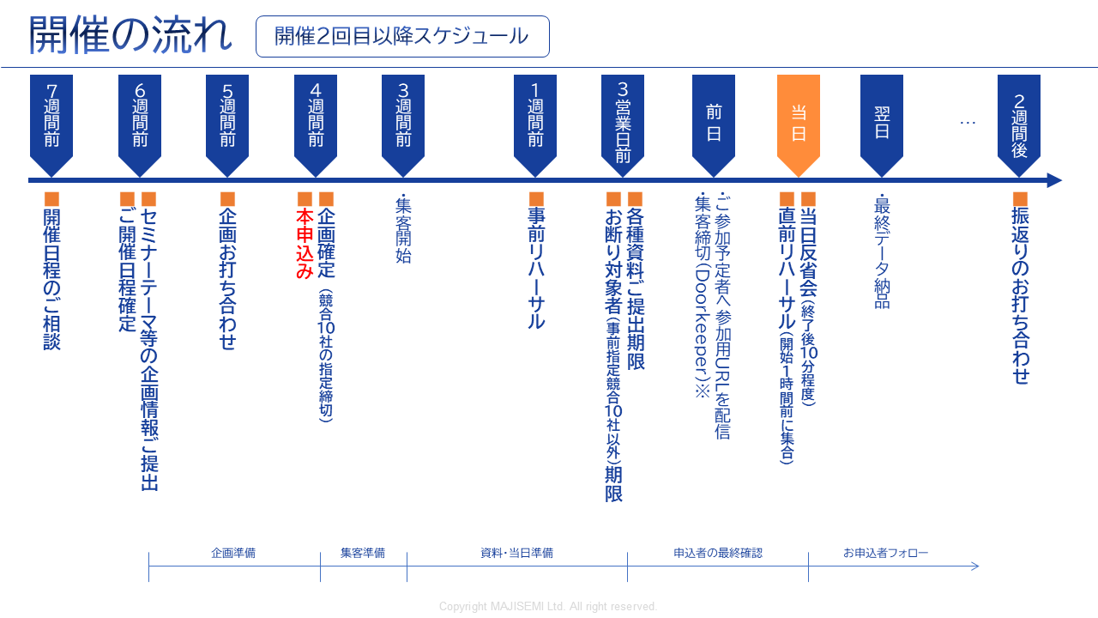
Webinar
as a Service
※To accommodate applicants, we cannot decline participation for those who apply within 2 business days before the event.
If you want to ensure competitors are excluded, set the application deadline 3 business days prior.
©2018-2024 MAJISEMI Inc.
©2018 MAJISEMI Inc.

Slide 38
Basic Plan
Majisemi Visitor
Plan details
Reference plan
Pricing Plans
This is a fully performance-based plan for holding a one-time webinar.
You can choose from 4 types of delegation levels.
We accept applications from 20 people.
If there are only 10 applicants, you will only be billed for 10.
14,500 yen per application (excluding tax)
・Held and applied for each time
・Performance-based billing according to the number of attendees
・Applications from 20 people or more
(Billing is only for the number of attendees)
*To accurately track the number of attendees, we will prepare the application page and provide the list to your company.
*The actual billing will be based on the number of applicants up to the maximum number above. If capacity is reached, we will stop accepting applications.
*For privacy protection, the list will be delivered directly to the seminar organizer.
*Billing will apply not only to participants but also to absentees (cancellations before or on the day).
*We will strive to attract as many attendees as possible, but we do not guarantee the number of attendees.
*There may be cases where no attendees are attracted due to the seminar theme or other concurrent events.
Management
Management
Menu |  | Planning | Attracting attendees LP setup | Moderator | Other media Import | URL delivery Reminder | Zoom Provision | Post-event Survey
Majisemi Visitor | Standard | ○ | ○ | ○ | No other media posting | ○ | ○ | ○
 | Planning and attracting attendees | ○ | ○ | - |  | - | - | -
 | Attracting attendees and management | - | ○ | ○ | - | ○ | ○ | ○
 | Attracting attendees only | - | ○ | - | - | - | - | -
Product name | Content | Quantity | Unit price (¥) | Amount (¥)
Majisemi Visitor (20 people) | Webinar Planning, attracting attendees, and management | 20 | 14,500 | 290,000
Visitor plan Reference plan for 20 people |  | Subtotal |  | 290,000
 |  | Consumption tax (10%) |  | 29,000
 |  | Total (including tax) |  | 319,000
©2018 MAJISEMI Inc.

Slide 39
Basic Plan
Majisemi Club Light
Plan details
Reference plan
Pricing Plans
Monthly fee 120,000 JPY (excluding tax) ※ Light plan includes 10 attendee slots
Additional attendee slots @10,000 JPY (excluding tax)
Automatic renewal every month
Add 10 attendee slots each month
Minimum webinar capacity is 30 people
If holding a 30-person webinar in the first month, purchase 20 additional attendee slots (@10,000 JPY)
If the number of attendees does not meet the capacity, the remaining slots will be carried over to the following months.
Additional attendee slots can be purchased for ¥10,000 each.
If someone who has registered for at least one of your company's last three paid seminars registers again for the current seminar, they will not be charged for the current seminar (fan development).
Other benefits include providing leads from those who download publicly available presentation materials, a branding dashboard, and a trend analysis tool.
Majisemi Club is a membership service that continuously holds webinars, applying PDCA to create better webinars. Admission is subject to review.
For Majisemi Club, we offer a one-stop service including planning, attracting attendees, hosting, and management. We cannot support attracting attendees only.
Furthermore, the seminar content (planning) will be a "problem-solving seminar" rather than a "product introduction." Product introductions will be conducted in the latter part of the presentation. The seminar content will be decided in consultation with the Majisemi planning team. It may not be possible to hold the seminar on your desired theme. If you wish to decide the theme yourself, please use the visitor option.
Please note that considering the purpose of the aforementioned Majisemi Club, a penalty will be set for cancellations within one year of the contract start. (The difference from the visitor fee will be charged)
*To accurately track the number of attendees, we will prepare the application page and provide the list to your company.
※ If the capacity is reached, we will stop accepting applications.
*For privacy protection, the list will be delivered directly to the seminar organizer.
※ Not only participants but also absentees (cancellations before and on the day) are counted in the number of attendees.
※ The contract is automatically renewed monthly and will continue in the same manner.
※ Refunds for unused attendee slots cannot be made upon withdrawal. Additionally, you cannot rejoin Majisemi Club for one year after withdrawal.
※ Please notify us by email by the end of the month prior to the withdrawal month.
※ Benefits are subject to change.
If you have challenges with converting seminars into business discussions or want to strengthen your website content and SEO, please consider our value set plan mentioned later.
Product name | Content | Category | Amount (¥)
Majisemi Club Light (30 participants) | Planning, attracting attendees, and managing webinars | Monthly fee | 120,000
Majisemi Club Light Plan Attracting 30 attendees, If you attract 10 attendees through the monthly fee and 20 through additional slots |  | Additional participant slots | 200,000
 |  | Consumption tax (10%) | 32,000
 |  | Total (including tax) | 352,000
©2018 MAJISEMI Inc.

Slide 40
Basic Plan
Majisemi Club Light
billing pattern
Pricing Plans
Example of hosting and billing for webinars with Majisemi Club
Add 10 attendee slots every month
Webinar
Held
Webinar
Held
Webinar
Held
seminars can be held anytime (or not at all)
(The target capacity is 30 or more attendees, and 10 or more for replays)
Webinar
Held
 | January | February | March | April | May | June | July | August | September | October | November
Additional attendance slots | +10 | +10 | +10 | +10 | +10 | +10 | +10 | +10 | +10 | +10 | +10
Beginning of the month Remaining Attendance Slots | 10 | 10 | 20 | 30 | 15 | 10 | 20 | 30 | 40 | 50 | 10
Monthly fee billing | 120,000 yen | 120,000 yen | 120,000 yen | 120,000 yen | 120,000 yen | 120,000 yen | 120,000 yen | 120,000 yen | 120,000 yen | 120,000 yen | 120,000 yen
Seminar hosting Target capacity | 30 participants |  |  | 30 participants | 50 participants |  |  |  |  | 50 participants
Seminar hosting Attendance results | 30 participants |  |  | 25 participants | 48 participants |  |  |  |  | 50 participants
Consumption of attendee slots | -10 |  |  | -25 | -15 |  |  |  |  | -50
End of month Remaining Attendance Slots | 0 | 10 | 20 | 5 | 0 | 10 | 20 | 30 | 40 | 0 | 10
Additional participant slots | 20 |  |  |  | 33
Additional participant slots billing | ¥200,000 |  |  |  | ¥330,000
The target capacity is 30 or more attendees
It's OK to hold events with 50, 100 attendees, etc.
It's OK to have a seminar with 30 attendees from the first month
carry over any shortfall to the next month
Any shortfall will be billed at ¥10,000 each
There will be no attendance beyond the target capacity
©2018 MAJISEMI Inc.

Slide 41

Basic Plan
Majisemi Club Business Negotiation Guarantee
Plan details
Reference plan
Pricing Plans
¥600,000 every three months (excluding tax)
Contract automatically renews every three months
Guarantees 30 attendees and 3 business discussions every three months
Majifolo is provided for free
If targets are not met, the shortfall will be carried over to future seminars
If more than 31 additional participants, ¥13,500 per registration
If someone who has registered for at least one of your company's last three paid seminars registers again for the current seminar, they will not be charged for the current seminar (fan development).
Other benefits include providing leads from those who download publicly available presentation materials, a branding dashboard, and a trend analysis tool.
This is a plan that automatically renews every three months. It guarantees 30 attendees and 3 business discussions (appointments).
We handle everything from planning the seminar content, attracting attendees, managing the event on the day, to sending materials to participants.
Majifolo is included in the fee.
If the initial seminar does not reach 30 attendees and 3 discussions, it will be carried over to that quarter or the next quarter,
or an additional seminar will be held. (The goal is to achieve this in the initial attempt)
※ To accurately track the number of attendees, we will prepare the registration page and provide the list to your company.
※ If the capacity is reached, we will stop accepting registrations.
*For privacy protection, the list will be delivered directly to the seminar organizer.
※ Not only participants but also absentees (cancellations before and on the day) are counted in the number of attendees.
※ The contract is automatically renewed every three months and will continue in the same manner.
※ Refunds for unused attendee slots cannot be made upon withdrawal. Additionally, you cannot rejoin Majisemi Club for one year after withdrawal.
※ To cancel, please notify us by email by the end of the month prior to the cancellation month.
※ We may not be able to accommodate guarantees for business discussions.
※ Benefits are subject to change.
Product name | Content | Quantity | Unit price (¥) | Amount (¥)
Majisemi Club event (30 participants) | Planning, attracting attendees, and managing webinars | 1 | 600,000 | 600,000
Majifolo (30 participants) | Appointment setting via phone and email for participants | 30 | 3,500 | 105,000
 | All cases free with Majisemi Club business meeting guarantee | 30 | -3,500 | -105,000
Majisemi Club Business Meeting Guarantee Plan Reference plan for 30 participants |  | Subtotal |  | 600,000
 |  | Consumption tax (10%) |  | 60,000
 |  | Total (including tax) |  | 660,000
Guaranteed attendance and business meetings!
©2018-2023 MAJISEMI Inc.

Slide 42
Majisemi Club's value plans (planned revision)
Pricing Plans
Recommended
 |  | Light | Silver | Gold | Platinum | Premium
Included services | Webinar hosting | ● | ● | ● | ● | ●
 | SEO article creation | ― | ●※1 | ― | ― | ●※1
 | MajiFollow | ― | ― | ●※2 | ●※2 | ●※2
 | MajiFollow Plus | ― | ― | ― | ●※3 | ●※3
 | Summary video | ― | ― | ― | ― | ●※1
Bonus additional attendance slots (Bonus) ※4 |  | ― | 10 people annually Equivalent to ¥100,000 | 20 people annually Equivalent to ¥200,000 | 40 people annually Equivalent to ¥400,000 | 80 people annually Equivalent to ¥800,000
Monthly fee |  | 120,000 yen | ¥135,000 | ¥155,000 | ¥255,000 | ¥385,000
Simply webinars
Only want to request hosting
Want to utilize presentation content
on the website
Want to follow up
immediately after the webinar
We will create an article of about 3,000 words with SEO in mind from the seminar's presentation content. By publishing it on your website, you can promote content marketing.
This is an option to provide seminar videos for secondary use.
*Provided free of charge within certain usage limits. During the trial, neither paid nor free provision is available.
When posting seminar videos on YouTube, etc., long videos tend to be disliked. Therefore, we will edit and provide them in about 5-10 minutes.
※1 SEO article creation and summary video creation can be conducted up to 4 times a year. Additional sessions can be purchased as an option.
※2 MajiFollow can be conducted for up to 120 people annually. Additional sessions can be purchased as an option.
※3 Includes monthly activity costs for MajiFollow Plus. A success fee of ¥30,000 per appointment is charged separately.
※4 The bonus additional attendance slots are granted one year after joining Majisemi Club and annually in the same month thereafter.
(All amounts are tax-excluded)
©2018 MAJISEMI Inc.

Slide 43
For those who registered for the seminar but were absent on the day, we will allow them to view the day's video.
Webinar
as a Service
Name | Price (excluding tax) | Content
MajiFollow (Post-seminar follow-up) | @3,500 yen × number of attendees | Majisemi's follow-up specialist staff will follow up with participants and absentees via email and phone immediately after the seminar ends.
SEO article creation | 200,000 yen | For those who have previously registered for your webinars (your prospective customers), we will plan and host themes that are more likely to lead to business negotiations (appointments), such as competitor comparisons, product introductions, demos, etc.
Full video provision/paid | ¥200,000 | We will manage your seminar operations on your behalf. This includes creating the registration page, managing registrants, lending Zoom, and moderating on the day. (Attracting attendees is not included. You will need to handle that.) *We offer it free of charge within certain usage limits. During the trial, neither paid nor free provision is available.
Summary video creation | 200,000 yen | When posting seminar videos on YouTube, etc., long videos tend to be disliked. Therefore, we will edit and provide them in about 5 to 10 minutes.
Missed session streaming | 200,000 yen | For those who registered for the seminar but were absent on the day, we will allow them to view the day's video.
Rebroadcast | Majisemi Representative Terada will facilitate presentations, discussions, and panel discussions at your seminar. Please consult on the theme. | Using recordings from past Majisemi events, we will hold additional webinars without hassle.
Two-step webinar | 200,000 yen | We will plan and hold a theme that leads to more business discussions (appointments) for those who have previously registered for your webinars (your prospective customers), such as competitor comparisons, product introductions, demos, etc.
Operational support (operation outsourcing) | 200,000 yen | We will handle the operation of your seminar. We will take care of tasks such as creating the registration page, managing registrants, lending Zoom, and moderating on the day. (Attracting attendees is not included. Please handle it yourself.)
Presentation by Majisemi representative Terada Presentation at your seminar | 300,000 JPY and up *1 SEO article creation and summary video creation can be conducted up to 4 times a year. Additional options can be purchased for more. | Majisemi representative Terada will facilitate presentations, discussions, and panel discussions at your seminar. Please consult with us regarding the theme.
*3 Includes monthly activity costs for Majifollow Plus. A success fee of 30,000 yen per appointment is charged separately. | *4 The additional attendee slot gift benefit is granted one year after joining Majisemi Club and every year thereafter in the same month. | "Evangelist AI" Digital Terada, utilizing generative AI, will deliver a keynote speech at your webinar. - Want to give a seminar presentation but don't have time to create the script and slides - No skilled presenters among employees (or they are too busy), so want to outsource the presentation as well
SEO video creation | 50,000 JPY per video and up ※In units of 10 sessions, excluding initial costs | This is a strategy to aim for top rankings in YouTube searches and Google video searches. Majisemi will create a custom AI avatar for your company and produce video content explaining terms. Scripts can also be delivered, and blog utilization is possible.
Product comparison video creation | 500,000 JPY and up *Excluding initial costs | We will create a competitive product comparison video to strongly recognize the strengths of your product. Majisemi will create a dedicated AI avatar for your company and produce product comparison video content. Distribution via webinars is also possible.
©2018 MAJISEMI Inc.

Slide 44
Notes
Webinar
as a Service
■ Generally, meetings start 6 weeks in advance, with the final application scheduled 4 weeks before the event.
Additional charges
Cancellation fees
For all services, if you cancel after making a "formal application" through Majikan (Majisemi management screen) or after we receive the order form/application form, a 100% cancellation fee will be charged.
However, for webinar events, the cancellation fee is capped at the equivalent of 20 visitors for general visitors and 30 slots for Majisemi Club members.
For Majifolo, the cancellation fee is capped at the equivalent of 20 visitors for general visitors and 30 slots for Majisemi Club members.
If adjustments to the title, announcement text, etc., are delayed and the webinar cannot be published by 5:00 PM, 10 business days before the event date, it will be treated as a cancellation and the above cancellation fee will be charged.
No refunds will be given for remaining attendee slots upon withdrawal from Majisemi Club.
Considering the purpose of Majisemi Club, a penalty is set for cancellations within one year from the start of the Majisemi Club contract. Please understand. (We will charge the difference from the visitor fee)
Majisemi Visitor
Orders placed less than 4 weeks before the event will incur a surcharge.
 | Unit price (excluding tax) | Upper limit specification
Base fee (Order placed more than 4 weeks before the event) | 14,500 JPY | More than 20 people
Order placed less than 4 weeks before the event | ×1.25 times surcharge
Order placed less than 3 weeks before the event | ×2 times surcharge
Various Majisemi Club
If the final application cannot be made 4 weeks before the event, there is no surcharge, but the event will be postponed upon consultation.
©2018 MAJISEMI Inc.

Slide 45
Majisemi Corporation

Slide 46

Company name
Headquarters location
Representative
Business activities
Seminar hosting achievements
Established
Capital
Number of employees
Majisemi Corporation
3rd Floor, Shiodome Building, 1-2-20 Kaiga n, Minato-ku, Tokyo 105-0022 Yuichi Terada
Operation of the IT and manufacturing industry-focused seminar marketing service "Majisemi"
Last year's achievements: approximately 1,000 events held, total attendance of about 60,000 people (2023)
January 2018
10 million JPY
45 employees
About Us
Company overview
Creating new encounters and experiences with digital products and services to promote the development of domestic industries and the advancement of engineers.
To achieve this, we communicate the potential of excellent technology to society, regardless of the size of the providing company.
We clearly convey to end users not the technology itself, but how it can solve their problems.
By 2025, we aim to host 2,000 webinars annually.
MISSION
Transform seminars into entertainment
Change society through seminars
Thanks to you, we achieved three No.1
achieved! 1
No.1 in seminars strong in attracting customers
Seminars chosen by
IT managers
No.1
For acquiring new business negotiations
Seminars strong in
No.1
©2018 MAJISEMI Inc.
Survey overview by Japan Marketing Research Organization: 2021 service comparison impression survey

Slide 47
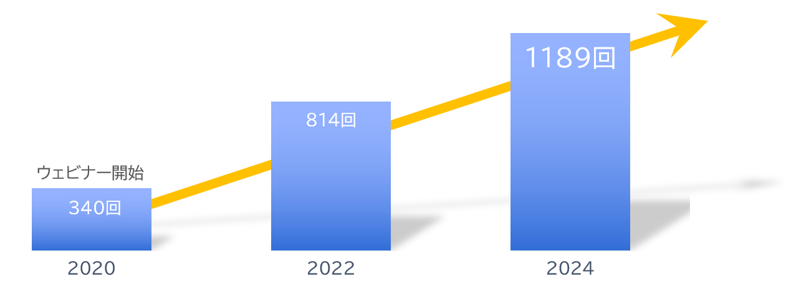
About Us
With clients
Number of seminars held
Increasing every year!
A10 Networks, Inc.
ITec Hankyu Hanshin Co., Ltd.
Advantech Co., Ltd.
AXIO Corporation
Assist Corporation
ITOCHU Techno-Solutions Corporation
Internet Initiative Japan Inc.
Infocom Corporation
Equinix Japan K.K.
SCSK Corporation
F-Secure Corporation
MOTEX Inc.
Encourage Technologies Co., Ltd.
Entrust Japan Co., Ltd.
OGIS-RI Co., Ltd.
OPRO Co., Ltd.
QlikTech Japan K.K.
Cross Head Co., Ltd.
KCCS Mobile Engineering Co., Ltd.
Serverworks Co., Ltd.
Sios Technology, Inc.
Cybertrust Japan Co., Ltd.
ZEAL Corporation
CTC System Management Corporation
Systena Corporation
Singapore Telecommunications Japan Co., Ltd.
GMO GlobalSign K.K.
JB Service Co., Ltd.
Startia Raise, Inc.
Smart Style Co., Ltd.
Sumitomo Electric Information Systems Co., Ltd.
Zoho Japan Corporation
Soliton Systems K.K.
Dynatrace
TIS Inc.
Techvan Co., Ltd.
TechMatrix Corporation
Delivery Consulting Inc.
Dell EMC
NSW Inc.
Hulinks Inc.
Netskope Japan Co., Ltd.
Pasona Tech, Inc.
Nippon Telegraph and Telephone East Corporation
Fujitsu Limited
Fujitsu Communication Services Limited
Fuji Electric IT Solutions Co., Ltd.
Mitsubishi Electric Information Systems Corporation
Mirantis Japan, Inc.
Monstar Lab, Inc.
Red Team Technologies, Inc.
Rosetta Corporation
(Agent)
MM Research Institute, Ltd.
Creative Bank Inc.
Target Media Co., Ltd.
Nikkei Advertising Inc.
Bigbeat Inc.
Mynavi Corporation
Transaction record
Major clients only, in alphabetical order
©2018 MAJISEMI Inc.

Slide 48
No.1 in seminars strong in attracting customers
No.1 in acquiring new business negotiations through seminars
No.1 seminar chosen by IT managers
Survey by Japan Marketing Research Organization Overview: 2021 Service Comparison Impression Survey
Transform seminars into entertainment
Change society through seminars

